Slide 1
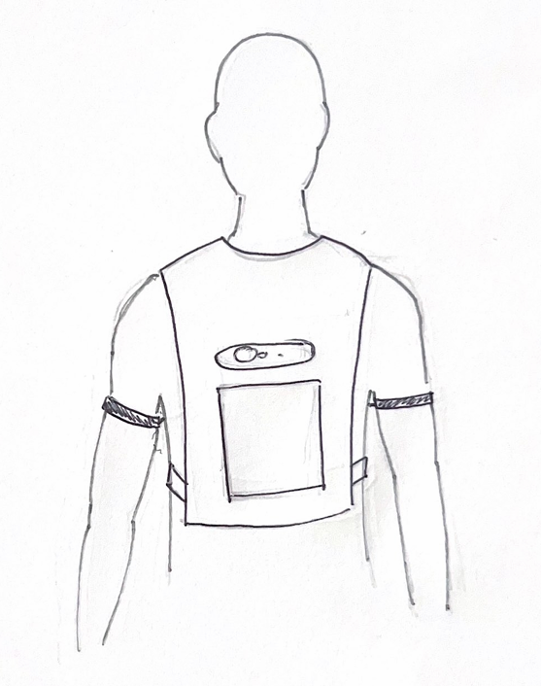
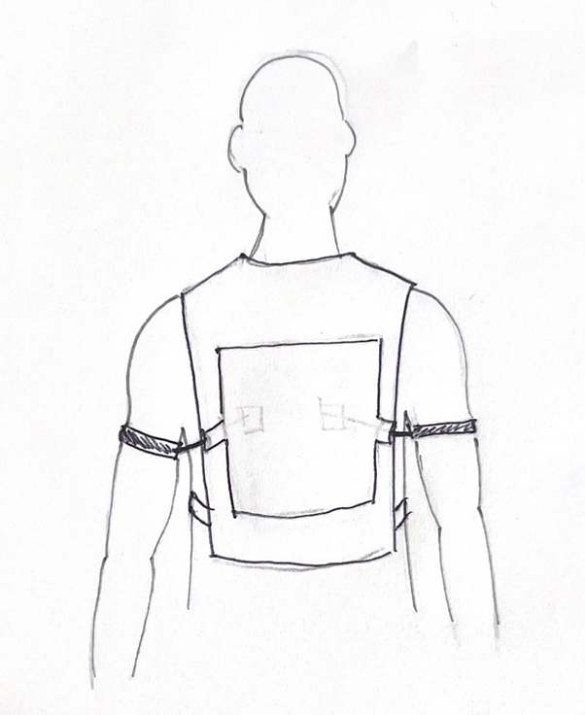
The user’s upper arm is pulled back to open the chest towards the desired direction of travel
FRONT
BACK

Slide 2
The user’s upper arm is pulled back to open the chest towards the desired direction of travel
FRONT
BACK
Lightweight vest

Slide 3
The user’s upper arm is pulled back to open the chest towards the desired direction of travel
FRONT
BACK
Lightweight vest
Camera/sensors

Slide 4
The user’s upper arm is pulled back to open the chest towards the desired direction of travel
FRONT
BACK
Lightweight vest
Camera/sensors
Storage pouch (battery pack)

Slide 5
The user’s upper arm is pulled back to open the chest towards the desired direction of travel
FRONT
BACK
Lightweight vest
Camera/sensors
Arm loops connected to ropes
Storage pouch (battery pack)

Slide 6
The user’s upper arm is pulled back to open the chest towards the desired direction of travel
FRONT
BACK
Lightweight vest
Motor driven pulley system
Camera/sensors
Arm loops connected to ropes
Storage pouch (battery pack)

